Slide 1

SAÉ 2.04 – DATABASE OPERATION
LESME Clément / PEREDERII Antoine / DUFOUR Vivien
Notes:
Hello,
we want to present our project for SAÉ 2.04 database operation.

Slide 2
SUMMARY
Dataset explanation
Database format
Graphs explanation
Notes:
First, we will tell you about our choice of dataset for this SAÉ.
Secondly, we will talk about our LDM and the various questions we asked ourselves about it.
Finally, we will explain the different grahics we were able to obtain with this dataset.

Slide 3

India Car Sales Dataset
Why did we choose this dataset ?
Notes:
We had chosen this database because we were looking for one on racing vehicles, but we couldn't find a good one in this subject, so we chose this one because it has a lot of detailed information on each vehicle. This dataset contains information on the various cars available on the Indian market. It was collected from CarDekho, an online car search and purchase platform. We selected the "car details v4.csv" file and we added two other csv files that we implemented by hand in order to obtain more information on the brand and people who founded or manage these brands.

Slide 4
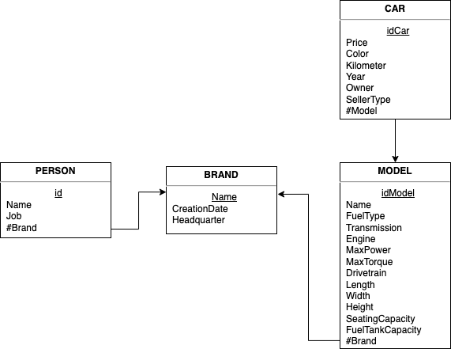
Our LDM and SQL tables
Why did we add data by ourselves?
Notes:
Here is the LDM with the different tables we have created with the various csv files above. The car and model tables is about the csv in kaggle. As for the tables we have added ourselves, we have decided to add a table containing information on brands, such as the date they were created and the location of their head office. We've also added a table with the names of the people working for these brands as CEOs or founders.

Slide 5
our main questions about this dataset
What influences the price of a vehicle?
Is there a link between the year of creation of a brand and the price?
Are any of the founders still in service as CEO?
What are the most common types of fuel used?
Notes:
our main problem was to ask ourselves what influences the price of a vehicle. For this, we compared different characteristics with the price of the vehicles available in the database.

Slide 6

Color code for graphs
Importance of variables on the price :
- Red : High
- Orange : Medium
- Blue : Low
Notes:
sort

Slide 7
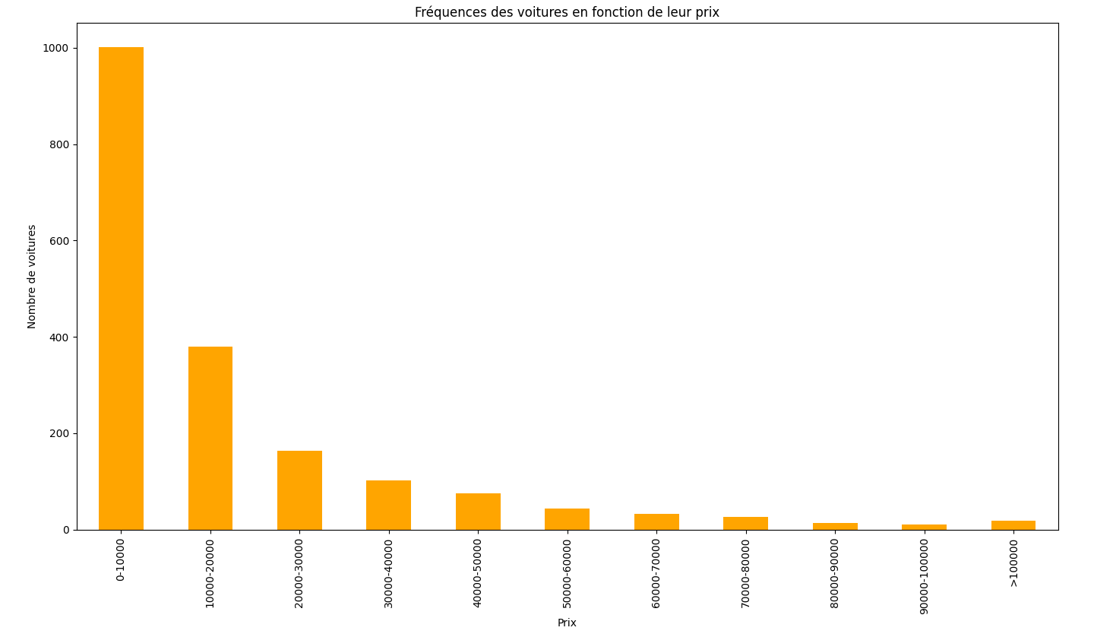
frequency of cars according to their price
Notes:
This graph shows the number of cars by price, to give an overview. We can see that most of the cars in our data are priced below €10,000, as they are often second-hand or low-performance cars. In all, over 75% of cars are priced below €50,000. We can therefore conclude that less than 1/4 (a quarter) of these cars are high-end sports cars or heavy-duty pick-ups.

Slide 8
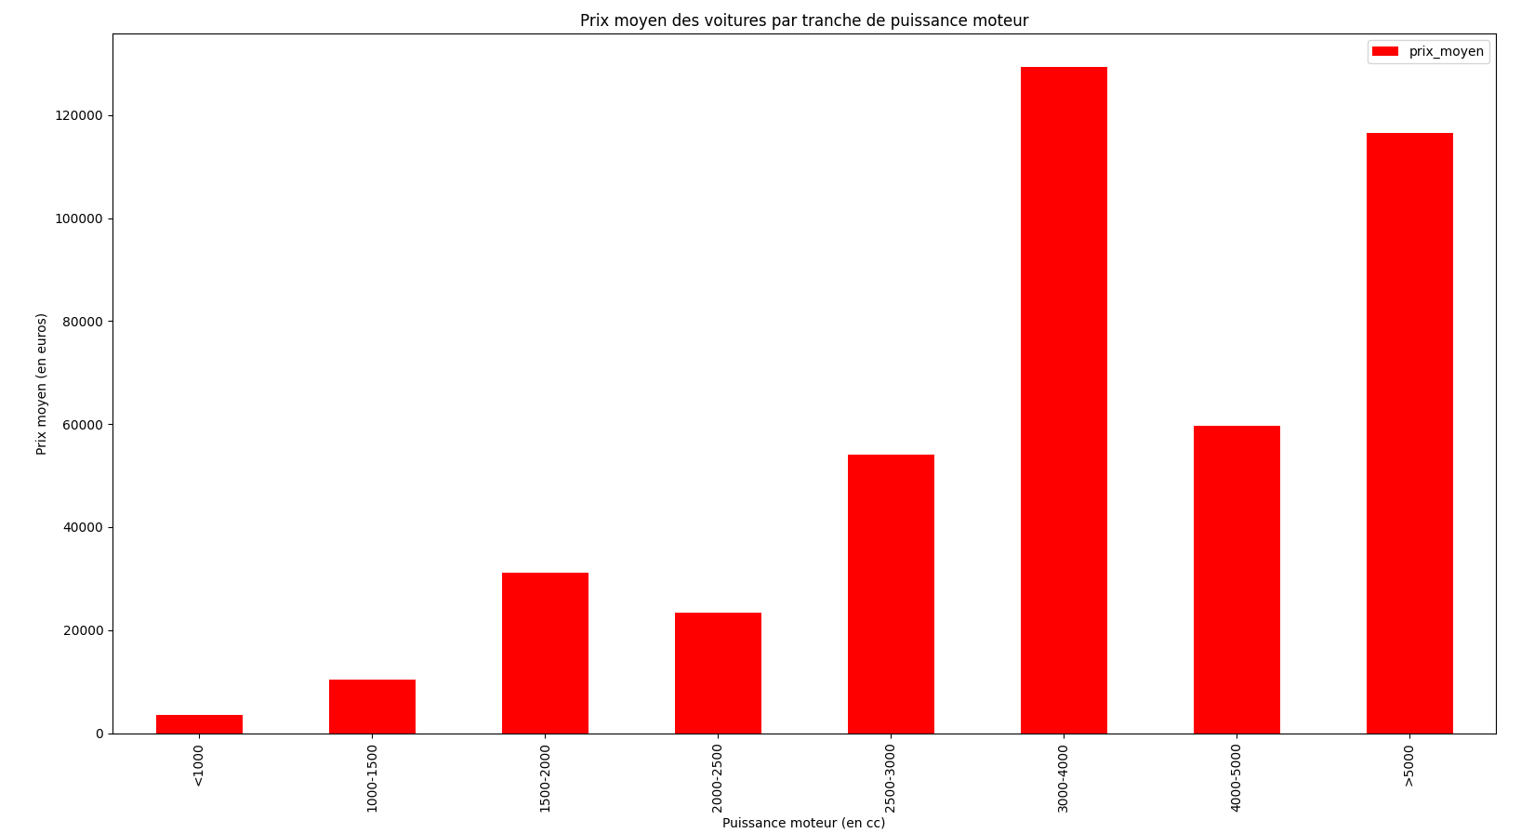
Average car price by engine power
Notes:
This graph shows a rather gradual increase in price according to engine power, followed by a meteoric rise between 3,000 and 4,000 cubic centimeters, certainly due to one or two very high-priced cars, breaking the homogeneity of average car prices in this bracket.

Slide 9
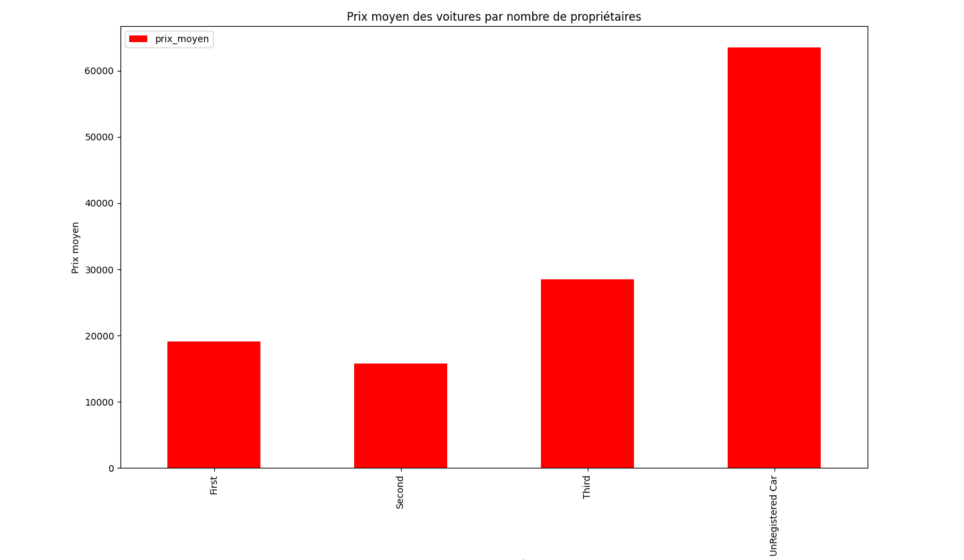
Average car price by number of owners
Notes:
We can see here that a new car costs double or even triple the price of a used car. We also learn that even if a car has a large number of previous owners, its price falls, but much less sharply than when it's new. We also note an increase in the price of vehicles on their third owner, which may seem counter-intuitive, but in reality can again be explained by the scarcity of older vehicles.

Slide 10
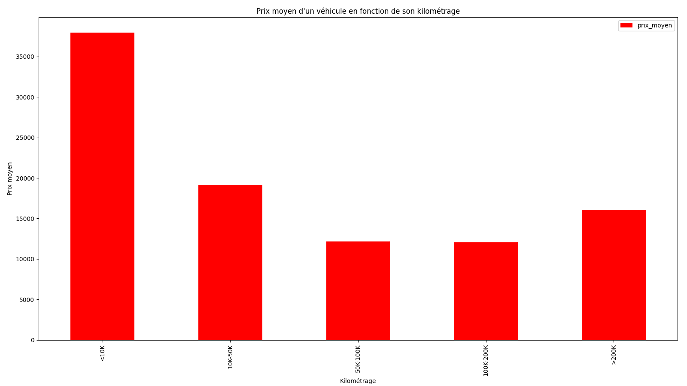
Average price of the cars according to its mileage
Notes:
The graph below shows that a vehicle's mileage is a key factor influencing its price. The lower the mileage, the higher the price, while the higher the mileage, the lower the price. On average, the price of a new or low-mileage vehicle is almost double that of one with over 10,000 kilometers on the odometer. However, vehicles with very high mileage may be worth slightly more, as they are generally older and therefore rarer on the market (collector vehicles).

Slide 11
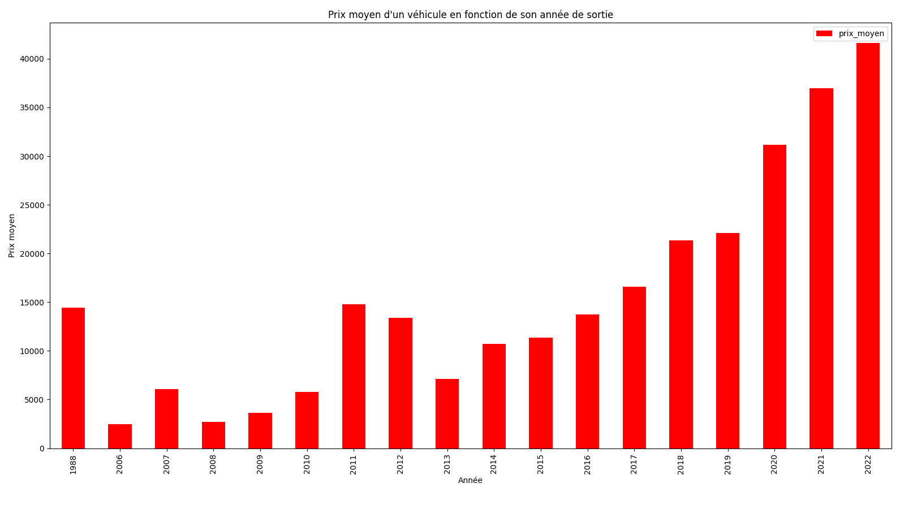
Average price of the cars according to its Realase year
Notes:
We can see from the graph above that the general trend is as follows: The newer the car, the higher the price.
However, this does not apply to vehicles more than 2 decades old, as these generally fall into the "Collectors' Vehicles" category, which significantly increases their price in view of their rarity.

Slide 12
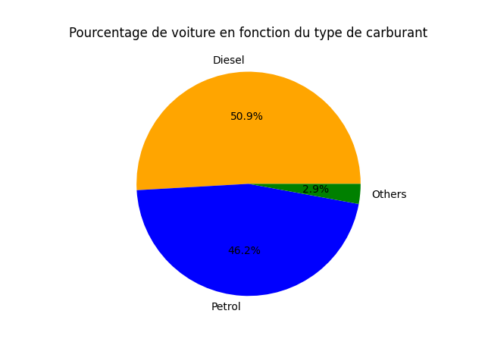
Percentage of cars by fuel type
Notes:
Here we've chosen a pie chart to get an easy idea of the proportions of each type of fuel. We can see that diesel and petrol cars are much more common than cars using other types of fuel, such as LPG.

Slide 13
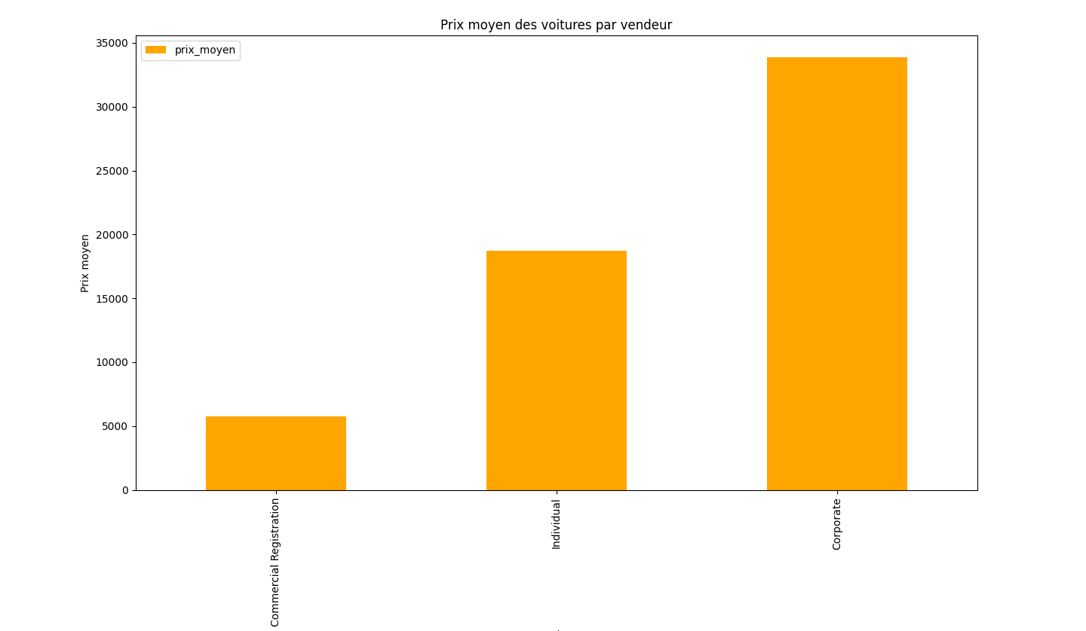
average price of cars by the type of the seller
Notes:
we can see from this graph that companies sell cars at almost 2 times the price of private individuals. This is consistent with the fact that cars sold by private individuals are almost always second-hand, whereas those sold by companies are either new or reconditioned, which greatly increases their price but brings a certain security and serenity to the buyer.

Slide 14
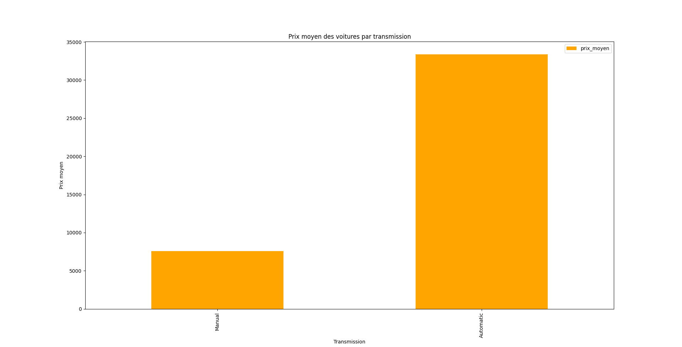
average car price by transmission type
Notes:
This graph helps us to know the average price of vehicles according to their type of gearbox box, so we can see a huge price difference between automatic and manual cars. On average, automatic cars are 5 times more expensive than manuals. This is because automatic cars are more complicated and therefore more expensive to produce. What's more, automatic gearboxes are much more common in sports cars than in everyday cars.

Slide 15
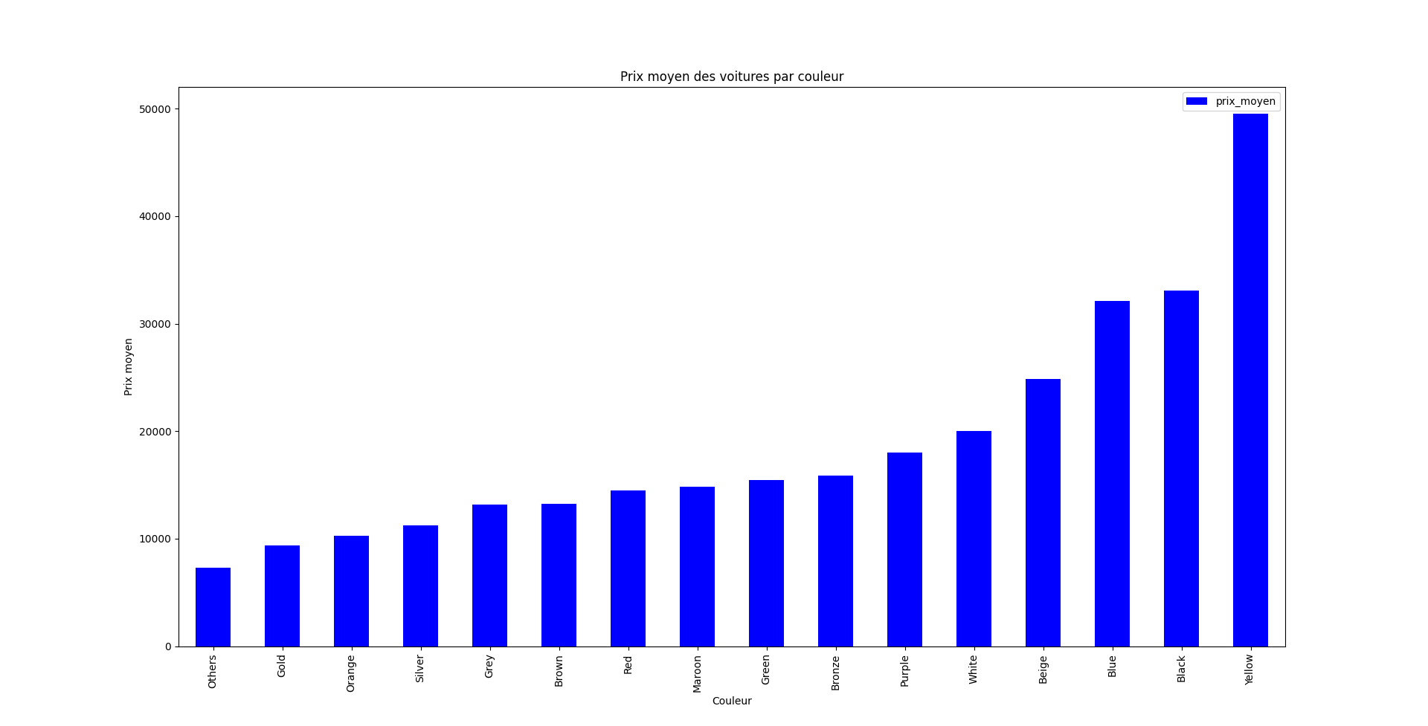
Average car Price according to their color
Notes:
This graph is not representative of reality, as several vehicles distort the database. For example, we have a relatively expensive yellow supercar, which distorts the average price. We can therefore say that color is not a major factor in the price of a vehicle (in differentiation from the vehicle's color options).

Slide 16

CONCLUSION
There are many factors that affect the price of the car :
New and recent vehicles, collection vehicles
Engine power
Length
Year of creation of the brand
Notes:
In conclusion, many factors influence vehicle prices, but new and more recent products are always preferred. However, many different types of vehicle, such as vintage, collectible and top-of-the-range vehicles, also have a major impact on prices.

Slide 17

But some data are IMPERFECT
In particular because of
high-end,
racing vehicle and
old vehicle

Slide 18



THANK YOU FOR YOUR ATTENTION
LESME Clément
PEREDERII Antoine
DUFOUR Vivien

