Slide 1

Administration
18 janvier 2024 – IUT Informatique Aubière
HeartTrack
Product-Owner : M. Samir
Antoine PINAGOT, Paul LEVRAULT, Antoine PEREDERII, Kevin MONTEIRO

Slide 2



Introduction
Notre projet :
Application Web & Mobile (PHP, Kotlin)
Analyse de courbes de fréquences cardiaques
Suivi sportif
Athlète & Coach
Heart
Track
Mobile
WEB
Administration :
Application WEB (Blazor)
Gestion des utilisateurs, activités, tickets et report
Admin & SuperAdmin
Admin

Slide 3


Sommaire
Cas d'utilisation
Architecture Blazor
Répartition des tâches

Slide 4
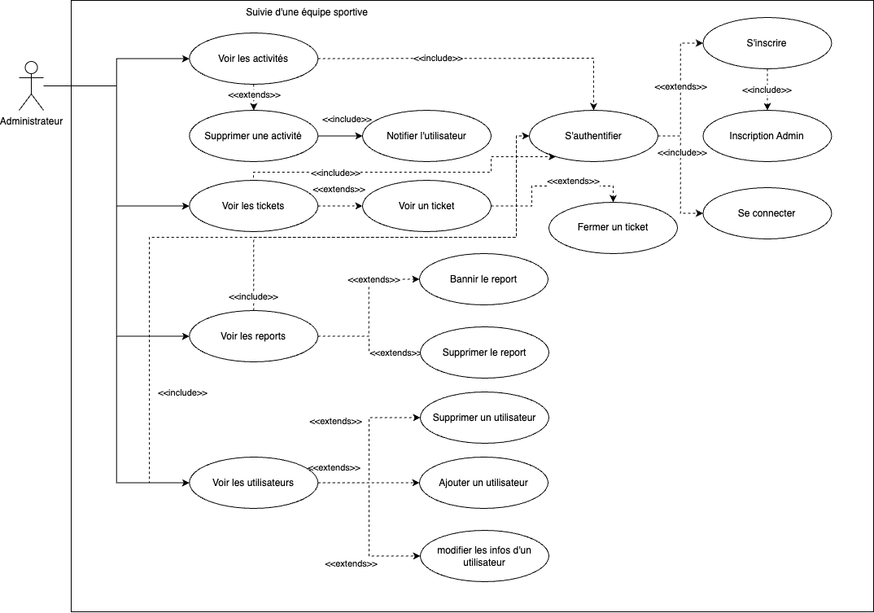
Cas d'utilisation

Slide 5




Blazor : Architecture
User
Models
Pages
Activities
Index
Errors
Activity
Tests
Reports
Ticket
Tickets
BanUsers
Blazor
Admin
ActivityDataService
DataLocalService
French
English
TicketDataService
Services
Ressources

Slide 6



Répartition des tâches
Services
Ressources
Admin Project
Models
API
Culture
Pages
Connexion

Slide 7
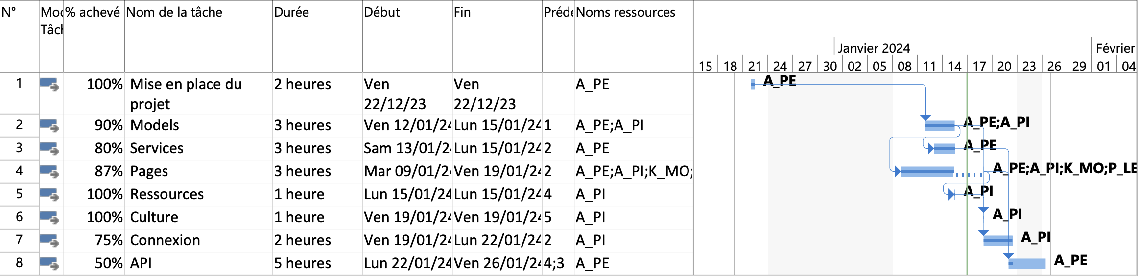
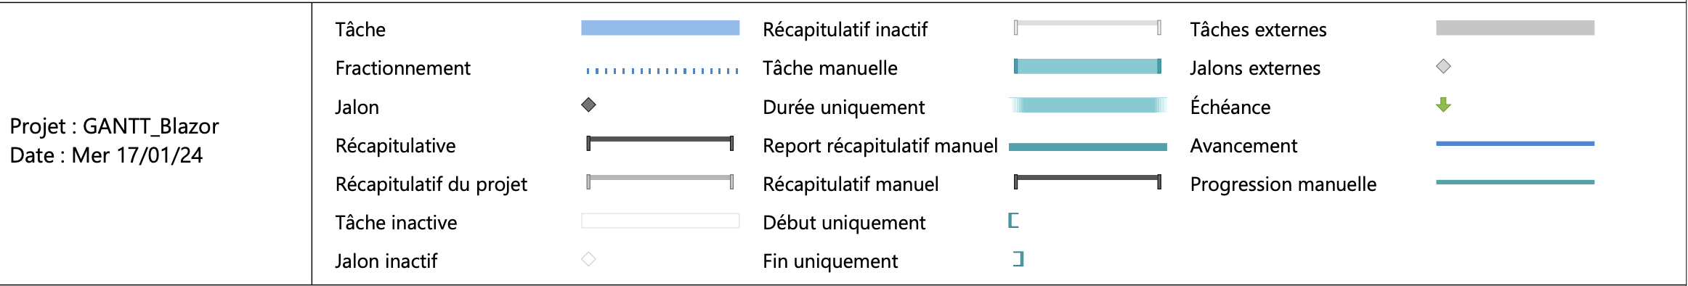
Répartition des tâches : GANTT

Slide 8
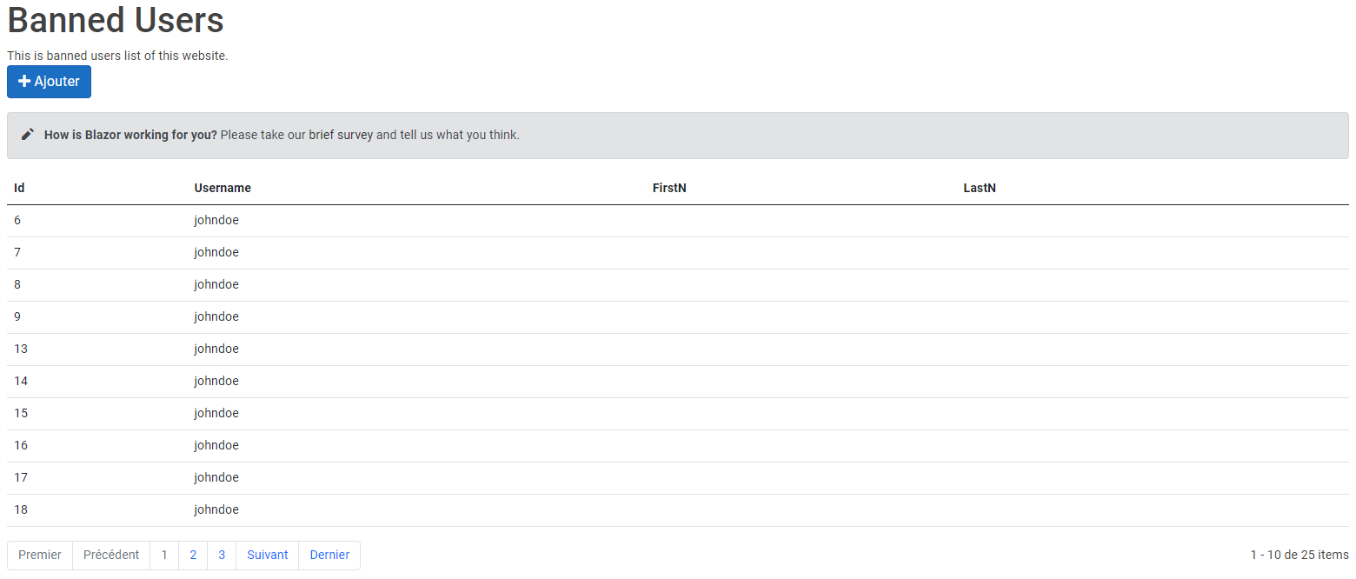
Partie individuelle: Kevin MONTEIRO : Les utilisateurs bannis

Slide 9


Partie individuelle: Antoine PEREDERII : Activités & API
Pages
DataServices
API
Routes
Requêtes
Méthode
Blazor
PHP
LocalStorage
JSON

Slide 10

Partie individuelle: Paul LEVRAULT : Signalements
Gestion des signalements :
Validation

Slide 11



Partie individuelle: Antoine PINAGOT: Architecture et Tickets
Ressources
Services
Factories
Pages
Models
Ticket
Culture

Slide 12
MERCI DE VOTRE ATTENTION

Slide 13
Conclusion

Slide 14
Try it out
1
Click Insert > Shapes to choose shapes for your branches and insert lines to connect each topic.
Right-click a shape to change its color.
Next, go to Insert > Text and type 1 or 2 keywords for each branch.
Go to Insert > Picture to add images and icons to your branch shapes.
Add your central idea
2
3
Add keyword
Add keyword
4
Add keyword
Add keyword

Slide 15




Example: Conference presentation
Borrowing Money
Saving for Retirement
Banking
Exit plan
Loan repayment
How much?
Financial planning
Staff
Equipment
Permits
Broker
Business Planning
Investing

Slide 16




Example: Vacation planning
Condo rental
Housing
Activities
Snorkel
Surf
Hotel
Whale watch
Hawaii
Flights
Take Out
Rental car
Grocery list
Travel
Food

Slide 17




Example: Class notes
Age 4.6B
The Sun
Planets
Mercury
Earth
Jupiter
Getting bigger
Mars
Saturn
Getting hotter
Venus
Neptune
Space
Uranus
Sirius
Canopus
Aldrin
Vega
Lovell
Notable stars
Notable astronauts

